Slide 1

Lesson Objective
Review
Dynamic memory
Files
Bit-wise

Slide 2
1. Dynamic memory
Static array
How to change size at run-time
Text
Data
Bss
Heap
Stack
Stack
Heap

Slide 3
1. Dynamic memory
Malloc
Calloc
Realloc
Free

Slide 4
2. Files (self-study)
Create file
Open file
Read file
Write to file

Slide 5
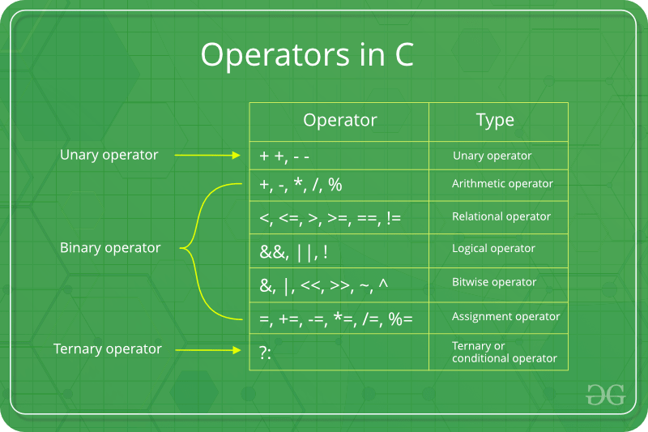
3. Bit-wise

Slide 6

4. Q&A

